Slide 1
OneU Use Case Voucher Analysis

Slide 2
1. Tình hình hoạt động của use case Voucher trên OneU
The most recent data shows a decline in daily claim count starting from mid-Feb.
Daily redeem count is stable however, after the decline on the 2nd week of Feb.

Slide 3
1. Tình hình hoạt động của use case Voucher trên OneU
Maybe best to use Total redeems / total claims. But seems the data contains some redeems without claims, making this impossible to calculate
Claim rate = Total claims / Total stock
Redemption rate = Total redeems / Total stock
Likely due to missing data
All top 10 performing vouchers achieved 100% claim rate.
MAA_GOGIHOUSE_27012024_SF4579 and xXC8900 attained the highest redemption rate of 72% and 66% respectively.

Slide 4
2. Category, Sub-category, voucher nào đang perform tốt trên ứng dụng.
Note: since 1 merchant can be associated with multiple categories (and sub-categories), a simple linear attribution model is applied to attribute each claim/redemption evenly to all categories under the merchant.
Claims from vouchers associated with merchant’s category / Total claimed vouchers
Redeems from vouchers associated with merchant’s category / Total redeemed vouchers
Historical data shows a strong favor towards Ẩm thực with 64.48% contribution towards all voucher claims.
Thời trang và Phong cách sống ranks 2nd at 12.23%, however this category performs much better in terms of redemption rate as compared to Ẩm thực.

Slide 5
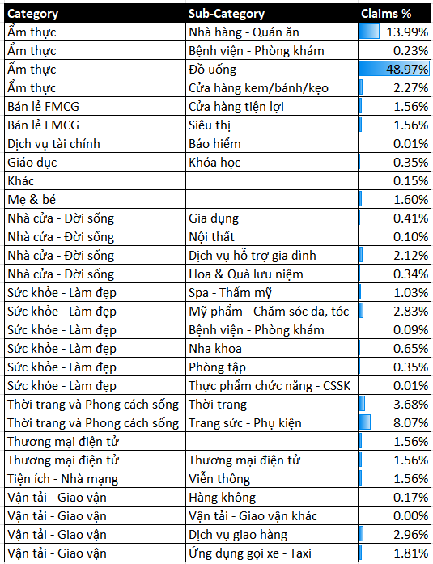
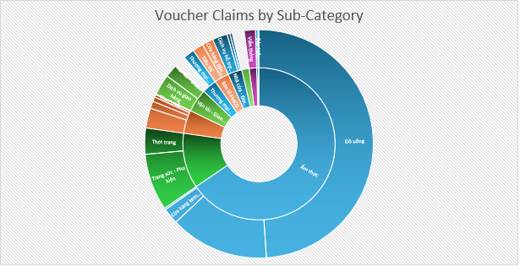
2. Category, Sub-category, voucher nào đang perform tốt trên ứng dụng.
Sub-category wise, Đồ uống under Ẩm thực contributes the majority to the claim count at 48.97%.
This is followed by Nhà hàng - Quán ăn and Trang sức - Phụ kiện at 13.99% and 8.07% respectively.

Slide 6
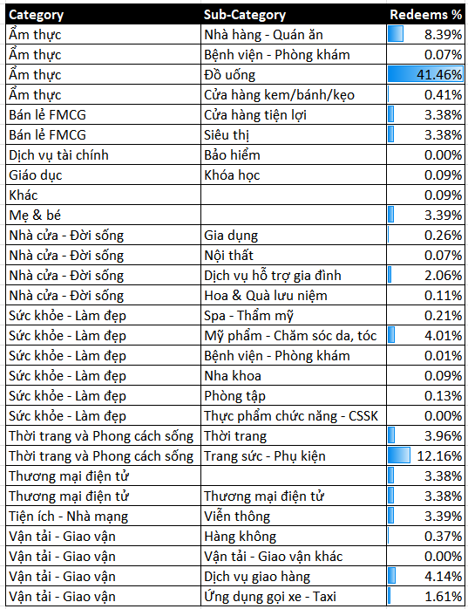
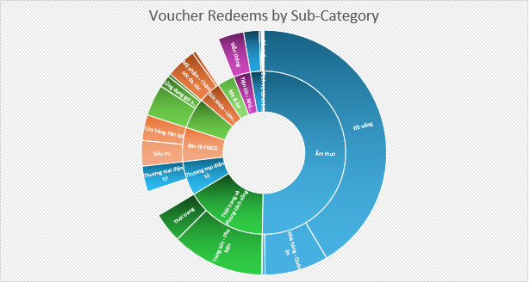
2. Category, Sub-category, voucher nào đang perform tốt trên ứng dụng.
A similar trend is observed under redemption rate.

Slide 7
2. Category, Sub-category, voucher nào đang perform tốt trên ứng dụng.
The top performers with regards to claim rate belong mostly to Discount Fixed Amount, Discount Percentage and Buy 2 get 1 types.
Cash Voucher achieved the highest redemption rate however, despite a relatively lower claim rate.

Slide 8
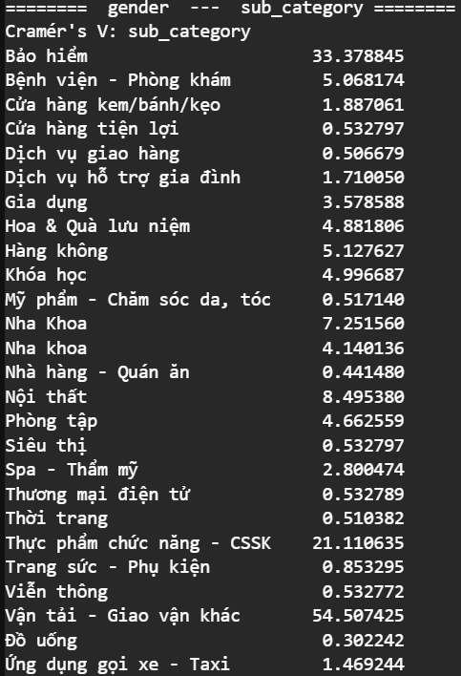
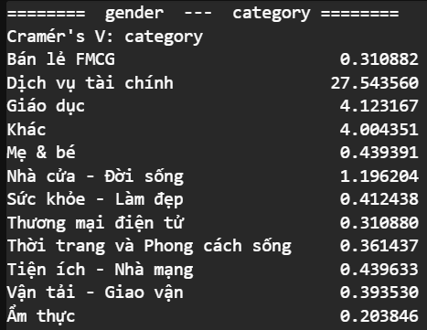
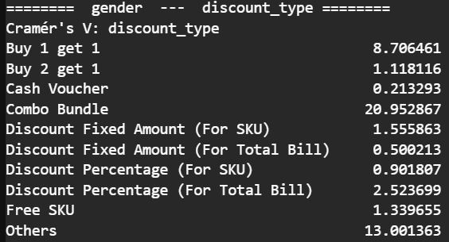
3. Category, Sub-category, voucher phù hợp với tập người dùng nào.
Shows a strong associations between gender and sub-category
Shows a strong associations between gender and discount-type
Shows a strong associations between gender and category
Users’ gender tend to show relatively close correlation with Dịch vụ tài chính, Vận tải - Giao vận khác and Combo Bundle.

Slide 9
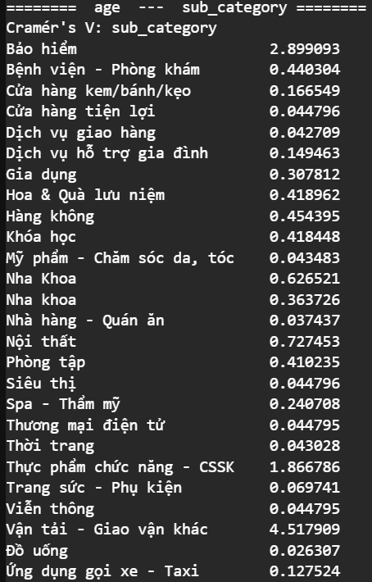
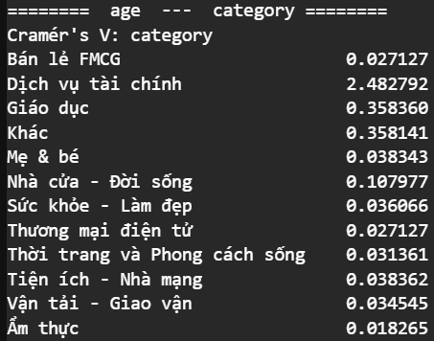
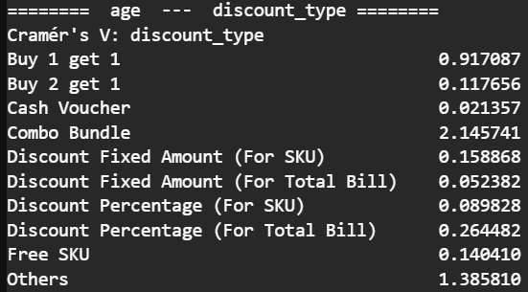
3. Category, Sub-category, voucher phù hợp với tập người dùng nào.
A very similar observation is made with regards to users’ age and category, sub-category and discount type.

